Slide 1
OSS Tools for System Management
Sanjula Ganepola, IBM
Software Developer
IBM i Development Tools and AI
Sanjula.Ganepola@ibm.com

Slide 2
Agenda
Current State of System Management on IBM i
Operational Monitoring with Prometheus
Data Visualization with Grafana
Event Monitoring with Manzan
Manzan + AI

Slide 3
Current State of System Management on IBM i

Slide 4
What tools are you using to monitor your IBM i systems?
Choose up to 3:
Dynatrace
Nagios
Instana
DataDog
Control4i
Syslog Reporting Manager (SRM)
Created your own
Other

Slide 5
Specialty is a collective disadvantage
Dynatrace
Nagios
Instana
DataDog
Control4i
Syslog Reporting Manager (SRM)
Created your own
Other
Each solutions has their own…
Configuration
Host installation requirements
Monitoring capabilities
Collect system metrics (active jobs, ASP consumption)
View sub system information
Identify long-running SQL
View job queue
Can you integrate with other tools?

Slide 6
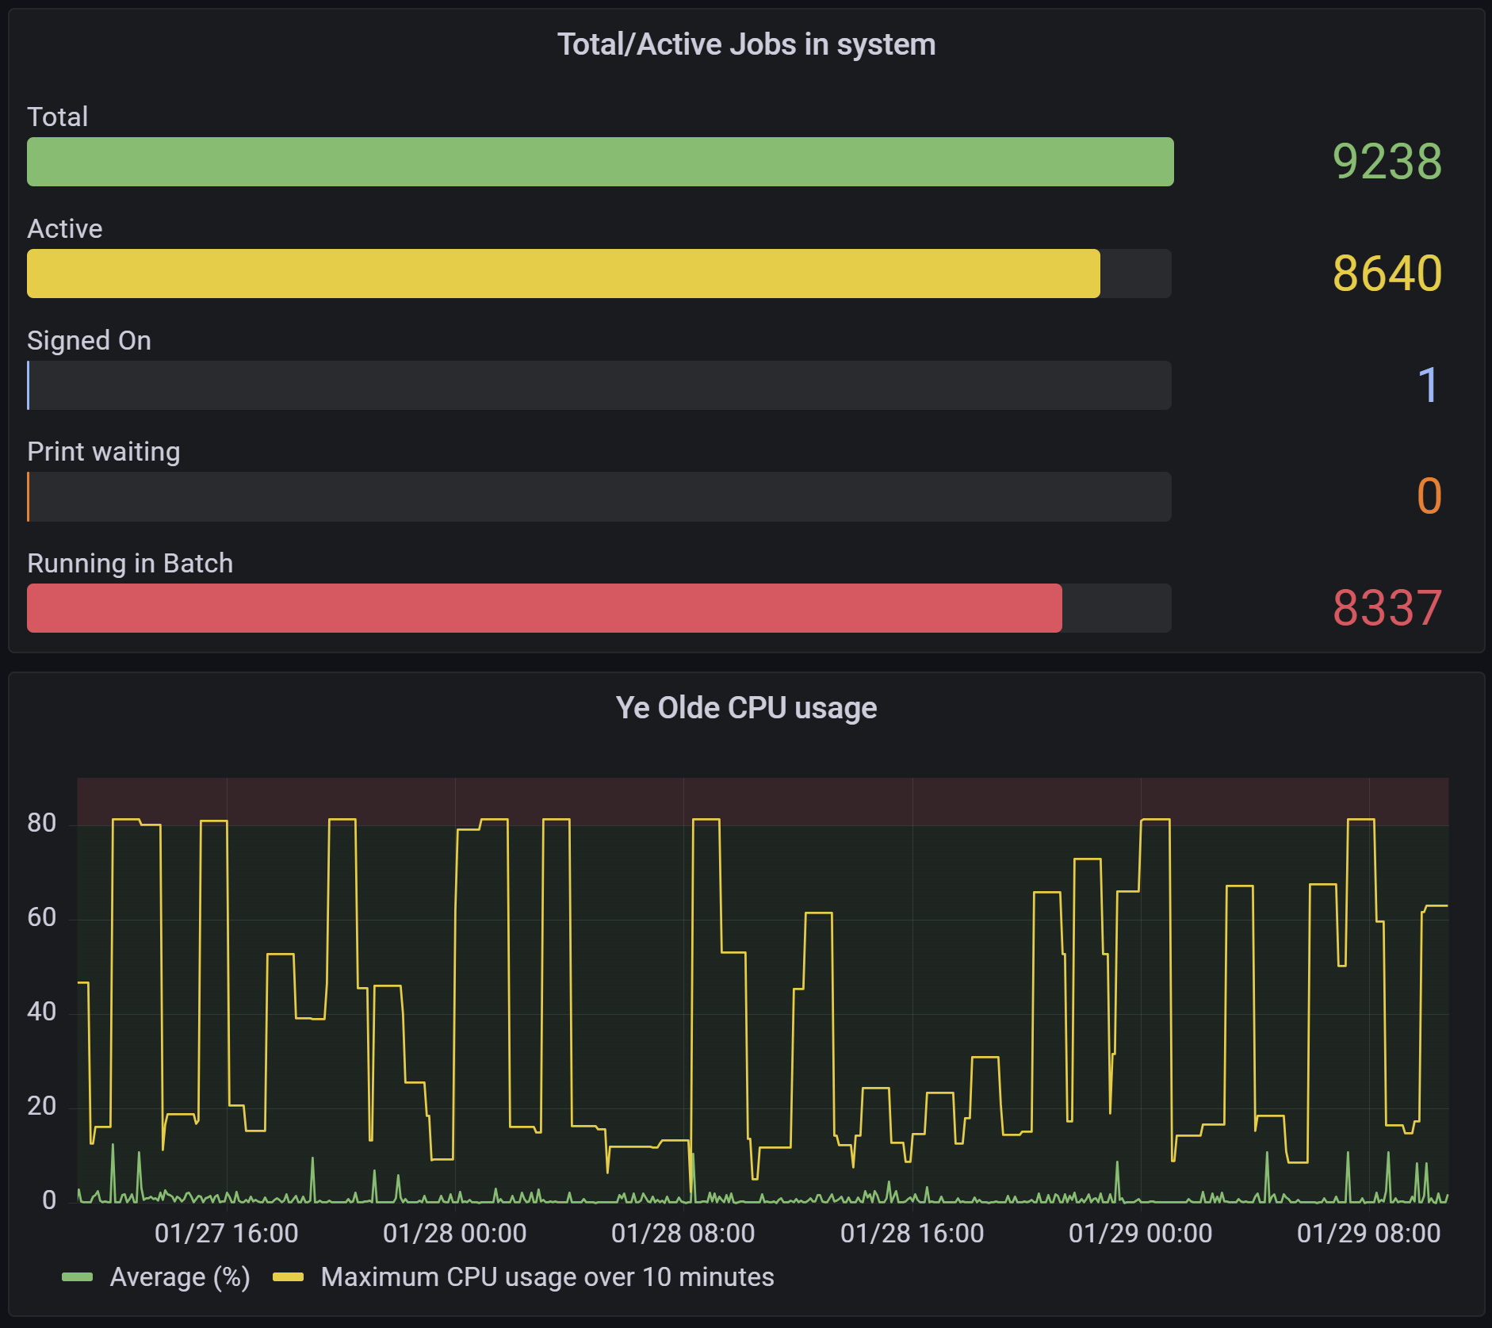
Do you use Grafana?
Choose 1:
Yes, with IBM i
Yes, but not with IBM i
No, but we want to
No, we don’t want to
No, don’t know what it is

Slide 7
Operational Monitoring with Prometheus

Slide 8

Prometheus Overview
What is it?
Leading open-source systems monitoring and alerting toolkit
Collects and stores metrics as timeseries data
Features
Multi-dimensional data model with time series data identified by metric name and labels
Provides a functional query language called PromQL
No reliance on distributed storage
Has an alert manager built-in
Easily paired with Grafana and other monitoring solutions

Slide 9
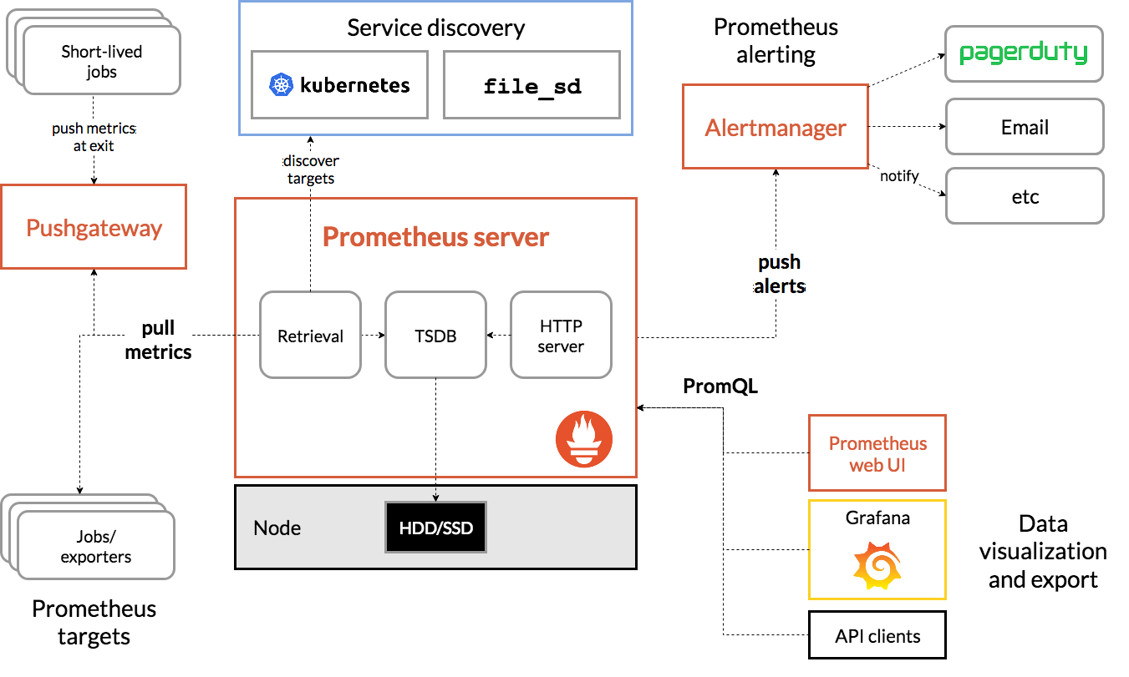
Prometheus Architecture

Slide 10

What do exporters do?
Collection of exporters: https://prometheus.io/docs/instrumenting/exporters/
Fetch metrics
Convert them to Prometheus format
Expose data via an HTTP endpoint for it to be scraped
Applications
Database
Host Machines
Containers
Pull metrics over HTTP

Slide 11
Data Model for TSDB
All data is stored as a time series: (timestamp, value)
Each time series has a name (metric name)
General feature of a system that is measured
Each time series can have key/value pairs (metric labels)
Identifies a particular dimension of the metric
Notation: <metric name>{<label name>=<label value>, ...}
api_http_requests_total{method="POST", endpoint="/messages"}
Time series is uniquely identified by metric name + metric label
temperature{city="Toronto"}
temperature{city="Rochester"}
Ordered by timestamp
Integer or fractional value

Slide 12
PromQL (Prometheus Query Language)
Functional query language that lets the user select and aggregate time series data in real time
Usage
Get/filter metrics we are interested in
Aggregate metrics
Build dashboards
Setup alerts
🛢️
Relational Database
SQL
🛢️
Time Series Database
PromQL

Slide 13
PromQL Basics
SQL | PromQL
select * from http_server_request_count | http_server_request_count
select * from http_server_request_count where uri=“/api/people” | http_server_request_count{uri=“/api/people”}
select * from http_server_request_count where uri=“/api/people” and method=“GET” | http_server_request_count{uri=“/api/people”, method=“GET”}
select * from http_server_request_count where status like ‘2%’ or status like ‘3%’ or status like ‘4%’ | http_server_request_count{status=~“2..|3..|4..”}

Slide 14
More PromQL Basics
Data Type | Expression | Example
Scalar | sum(http_server_request_count) | 20
Instant Vector | http_server_request_count | 20@1708759057
Range Vector | http_server_request_count[3m] | 20@1609746001 20@1609746041 20@1609746121
💡rate() function can then be used to calculates the average rate of increase on a range vector

Slide 15

How to use Prometheus with IBM i

Slide 16
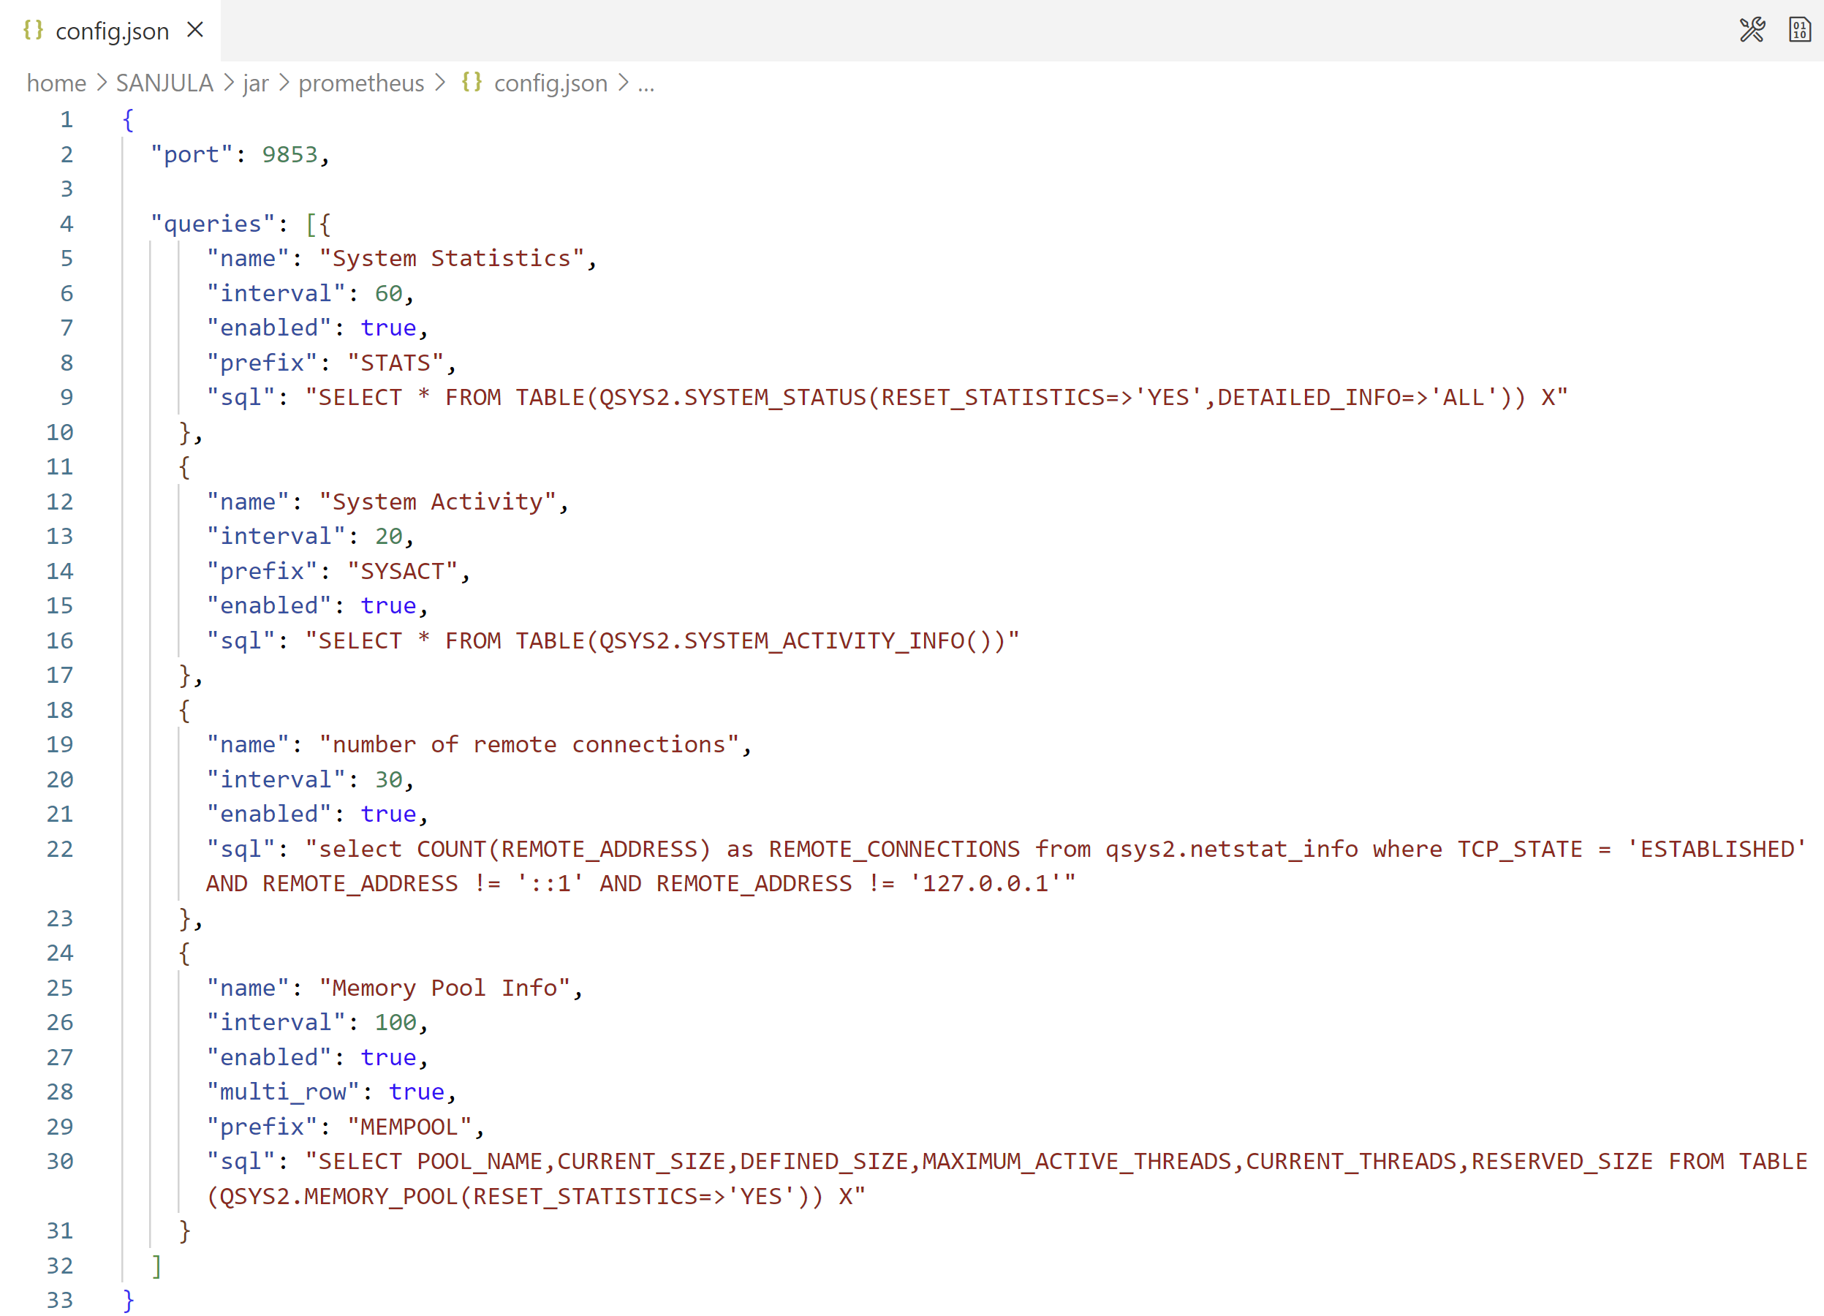
IBM i Prometheus Exporter
JDBC-based exporter that leverages SQL to export IBM i metrics
Exports hundreds of metrics including:
System activity levels (such as CPU usage)
Memory pool information
Apache HTTP server metrics
Number of remote TCP connections
User customizable metrics with SQL
https://github.com/ThePrez/prometheus-exporter-jdbc

Slide 17
Deploying the IBM i Prometheus Exporter
Video Demo: https://www.youtube.com/watch?v=qIcAx4lJZIA
1. Download latest .jar file from release page and store in the IFS:
wget https://github.com/ThePrez/prometheus-exporter-jdbc/releases/latest/download/prom-client-ibmi.jar
2. If this is your first time, create a default configuration file (config.json):
java -jar prom-client-ibmi.jar
3. Respond with y for the following message:
Configuration file config.json not found. Would you like to initialize one with defaults? [y]
4. Confirm the Prometheus client has started:
==============================================================
Successfully started Prometheus client on port 9853 ==============================================================
5. Create a service commander configuration file (prometheus.yml) and start it:
java -jar prom-client-ibmi.jar sc
sc start prometheus.yml

Slide 18
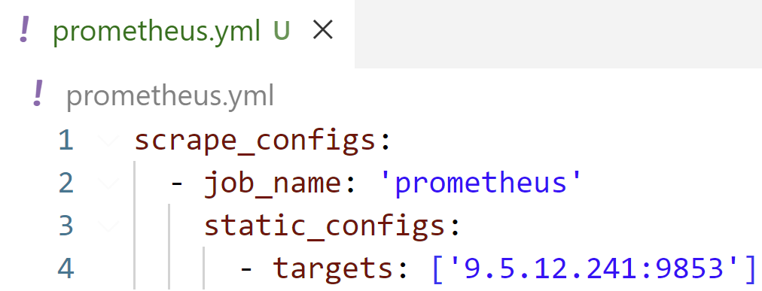
Deploying the Prometheus Instance
1. Download the Prometheus-provided image from Docker Hub to some central location:
docker pull prom/prometheus
or
podman pull docker.io/prom/prometheus
2. Create a Prometheus configuration file (prometheus.yml):
3. Launch the image in a container named “prometheus”:
docker run -d --name=prometheus -v /path/to/prometheus.yml:/etc/prometheus/prometheus.yml -p 9090:9090 prom/prometheus
or
podman run -d --name=prometheus -v /path/to/prometheus.yml:/etc/prometheus/prometheus.yml -p 9090:9090 prom/prometheus
4. Navigate to Prometheus web UI at http://<container_ip>:9090

Slide 19
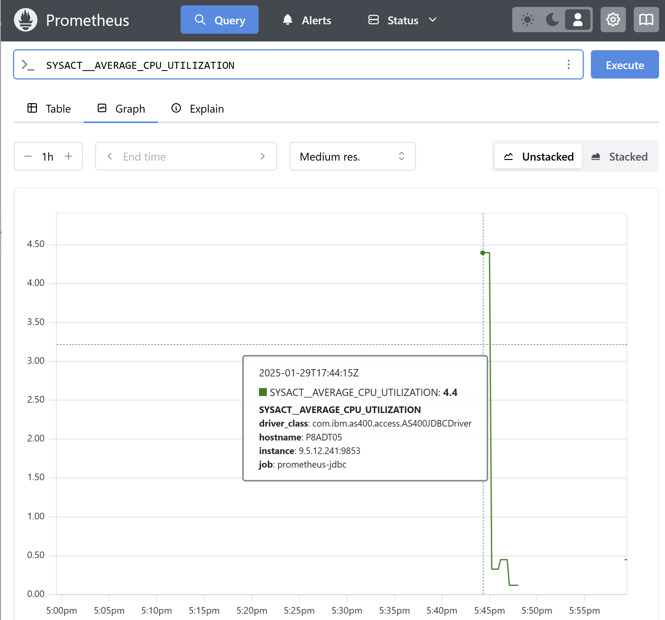
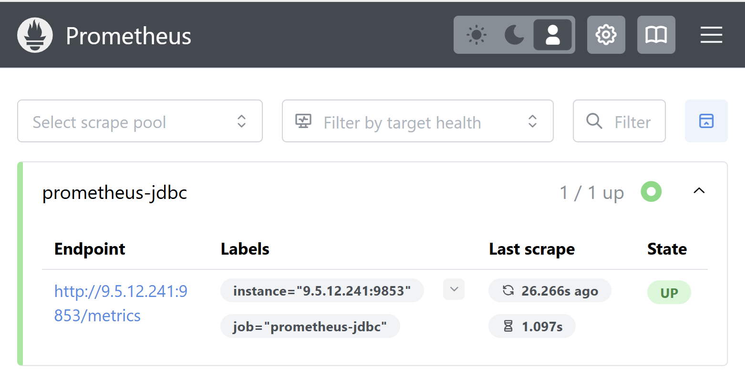
Prometheus Web UI
Graphing Historical Metric Data
Target System Status
Blog post by Jesse Gorzinski: "Monitoring IBM i with Prometheus"
https://techchannel.com/open-source-on-ibm-i/monitoring-ibm-i-with-prometheus/

Slide 20








Prometheus can be the bridge to other solutions

Slide 21
Data Visualization with Grafana

Slide 22
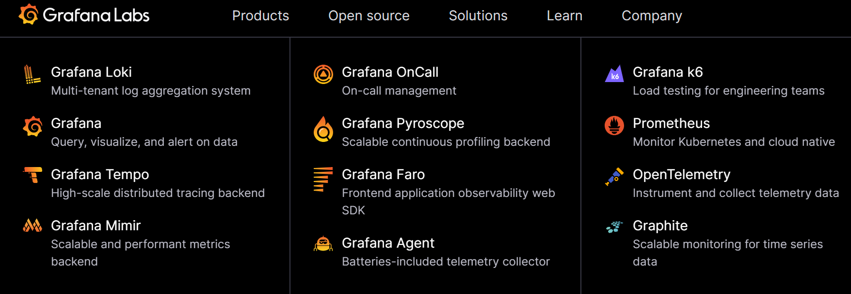
Grafana Overview
Open-source analytics, visualization, and monitoring solution
Driven by Grafana Labs. Plenty of open-source components. See https://grafana.com/
Over 300 plugins available

Slide 23
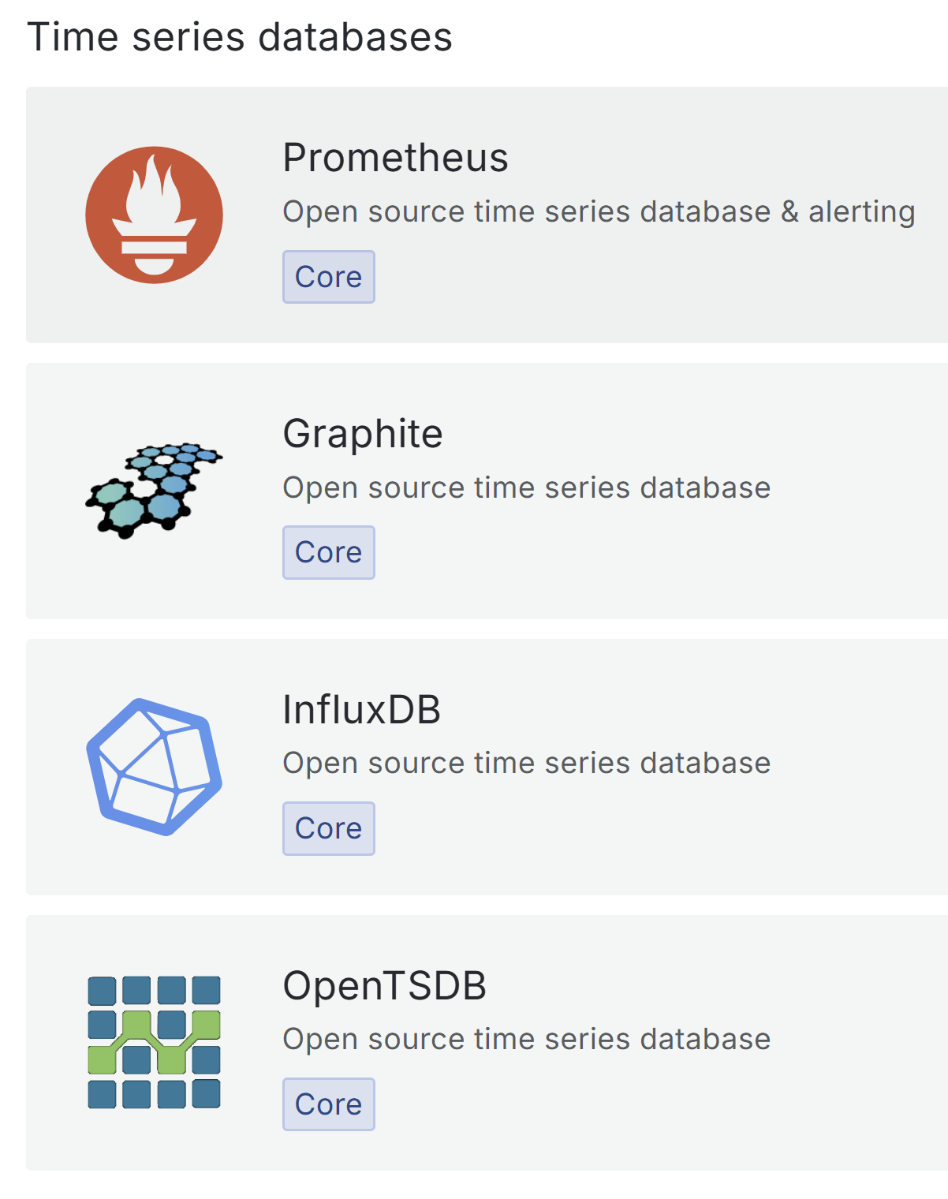
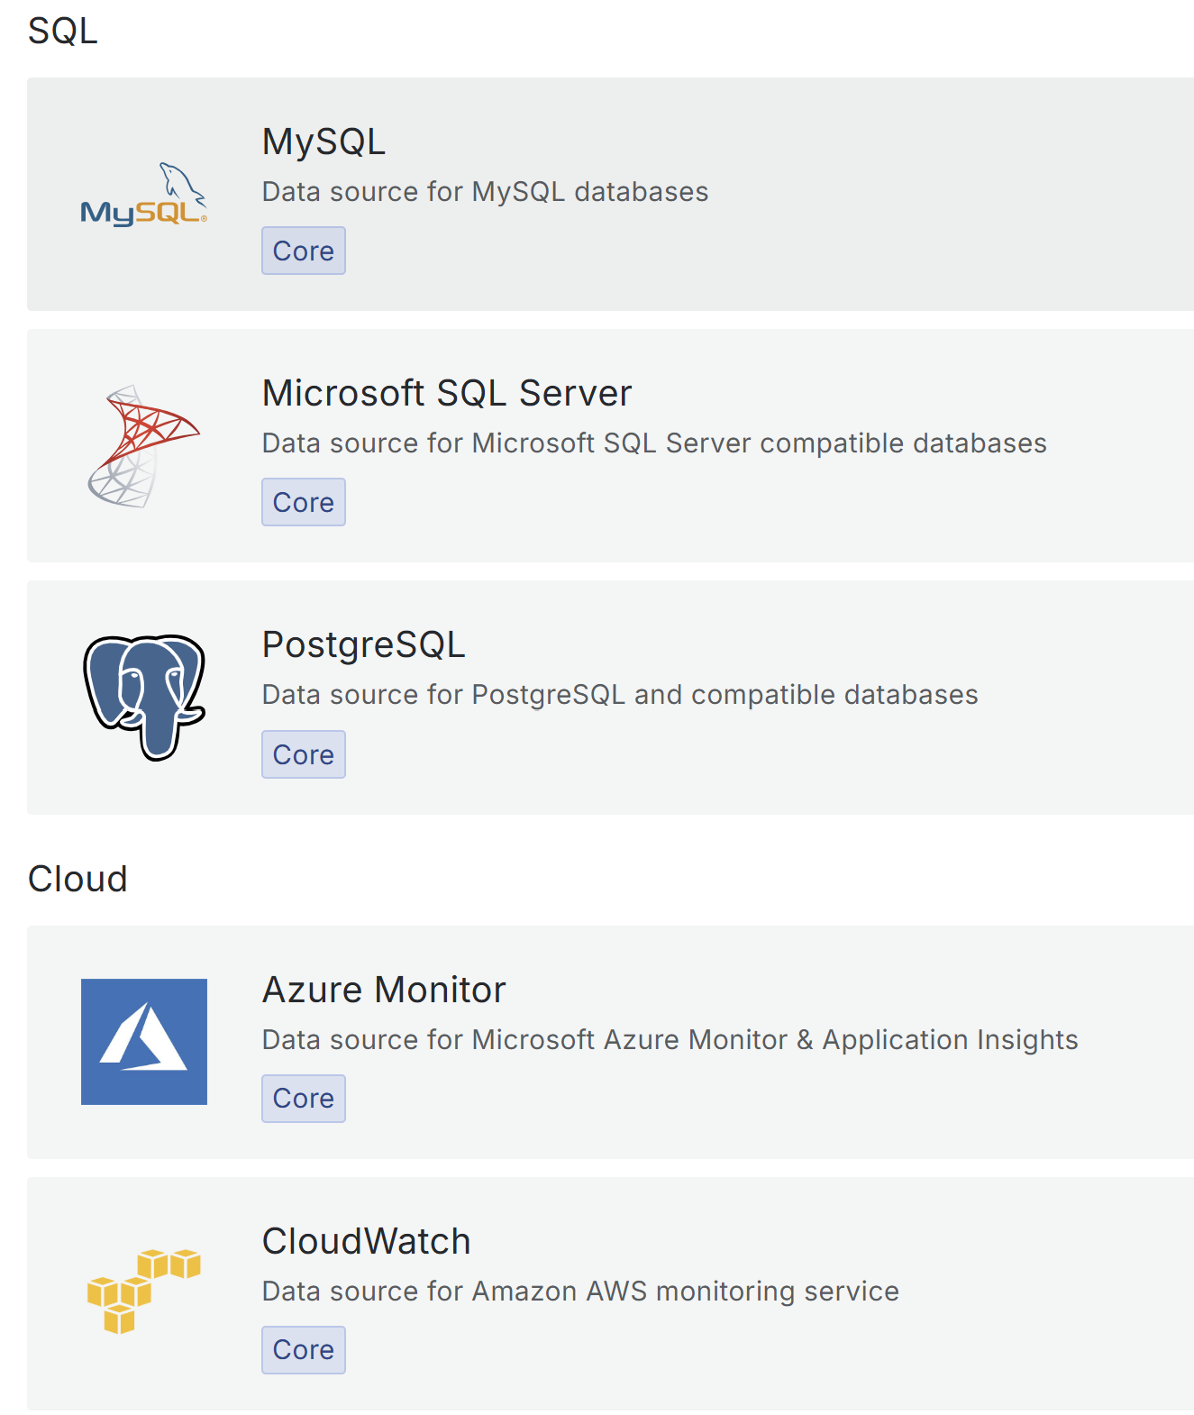
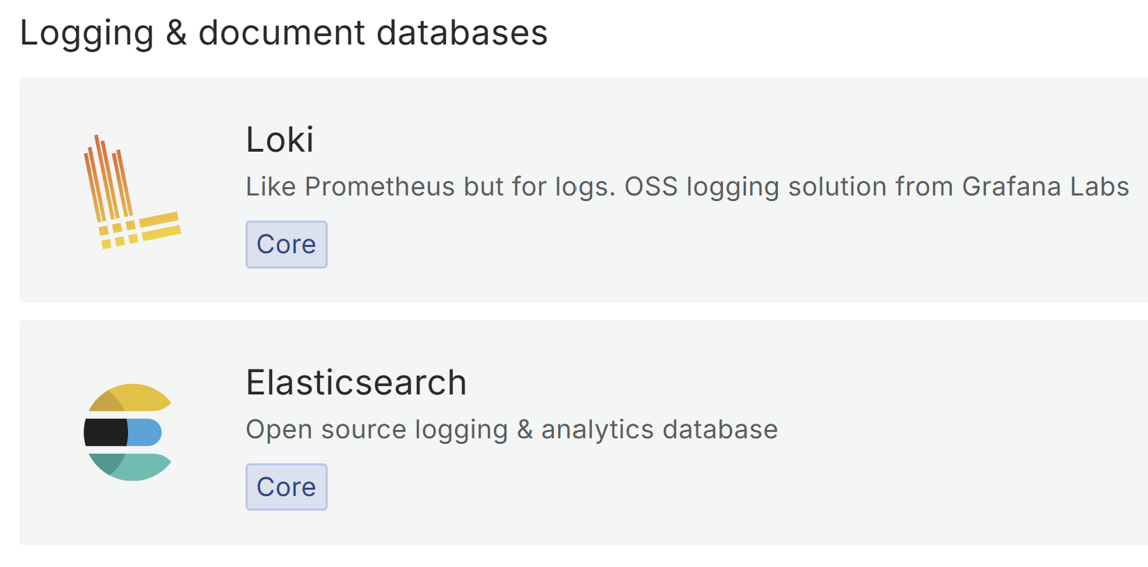
Grafana Data Sources

Slide 24
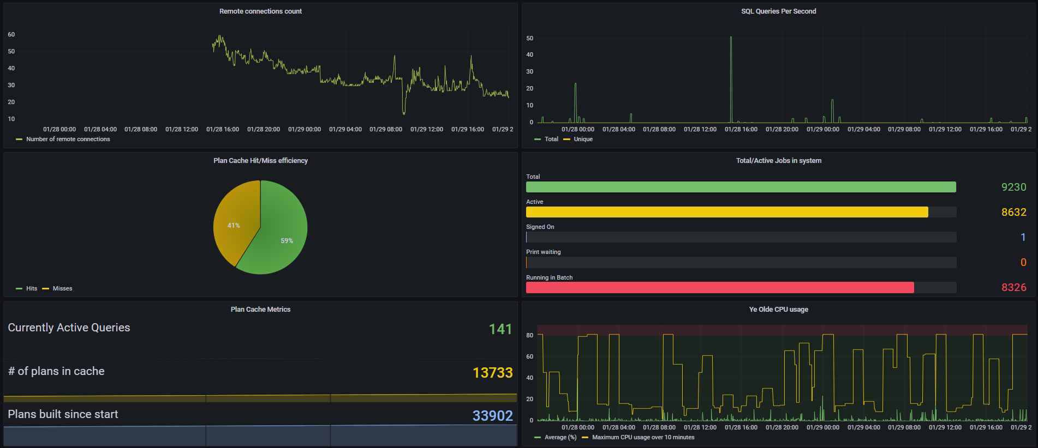
Prometheus Visualization with Grafana
Public COMMON1 Grafana Dashboard: http://ibm.biz/ibmi-prometheus

Slide 25
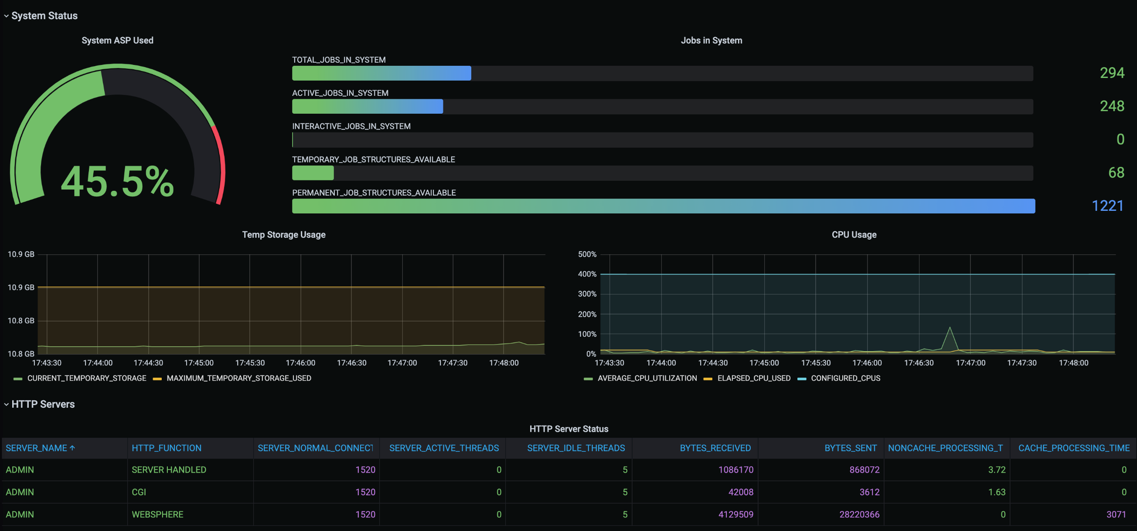
Grafana Backend (Without Prometheus)
Blog post by Jesse Gorzinski: "How to Deploy a Simple Grafana Dashboard“ https://techchannel.com/performance/how-to-deploy-a-simple-grafana-dashboard/

Slide 26
Grafana with or without Prometheus
 | With Prometheus | Straight to Grafana
Persistent storage | Prometheus | Grafana
Persistent storage of unused metrics | Prometheus | --
Metric type | Numerics | Numerics/strings/other
Ecosystem | Extremely Broad | There
Scalability | Excellent | Good
IBM i requisites | None | Node.js
Initial setup | Easier | Easy

Slide 27
Event Monitoring with Manzan

Slide 28
Manzan Overview
Open-source event handling tool designed to simplify handling of system events
Serves as a gateway for publishing IBM i events to a variety of endpoints:
User applications
External resources
Open-source technologies
Example use cases:
Monitor system events with a third-party open source or proprietary tool
Consolidate logs for auditing/reporting + query for system events
Feed real-time system event data into stream processing systems (such as Apache Kafka)
Send alerts for system events
Full Documentation: https://theprez.github.io/Manzan/#/

Slide 29
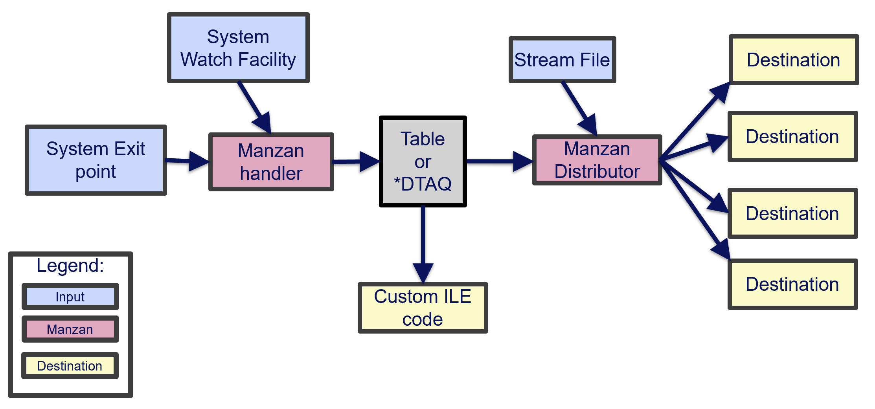
Understanding the Architecture

Slide 30
What are inputs?
Inputs: Sources of your data
Stream file
System watch facility (STRWCH)
MSGQ
LIC logs
PAL logs
System exit points (coming soon)
Audit journals (coming soon)

Slide 31
So practically what can Manzan monitor?
Application crashes
History Log entries
Log data
Specific entries in log data
System Limits alerts
Problem log entries
*SYSOPR messages
Specific job log messages
Audit journal events (future)
PAL entries
Fishy TCP connections (future)
VLOGs

Slide 32
What are destinations?
Destinations: Locations to send data
Built-in supported destinations:
HTTP/HTTPS endpoints (REST, etc.)
Email (SMTP/SMTPS)
SMS (via Twilio)
Slack
FluentD
Kafka
Sentry
Grafana Loki
Google Pub/Sub
ActiveMQ
Custom ILE Code

Slide 33
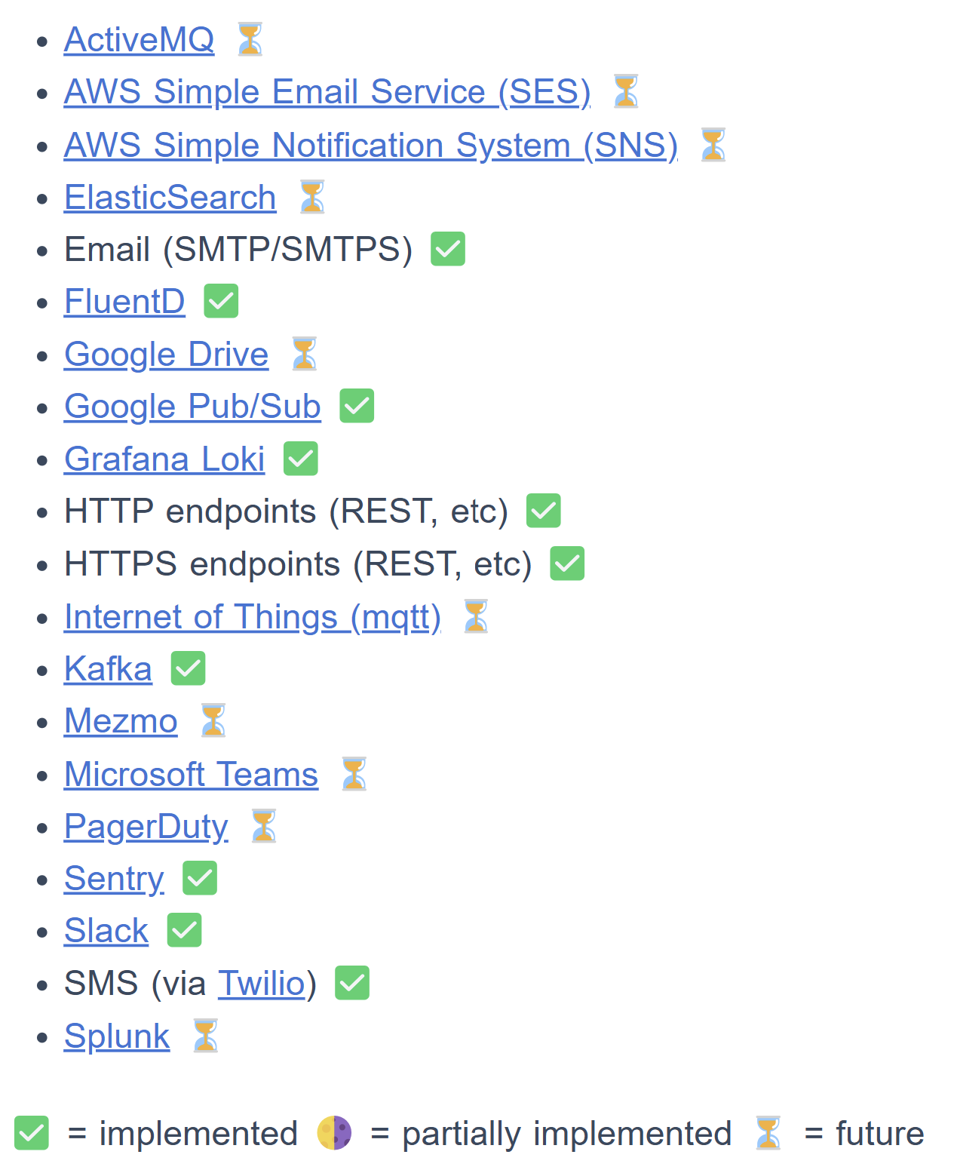
Can Manzan send data anywhere?
Many destinations are already working, but there are more to come
Track supported destinations: https://theprez.github.io/Manzan/#/?id=where-can-i-send-these-events
Desired target not on the list? Please open an issue to the repository and let us know!

Slide 34
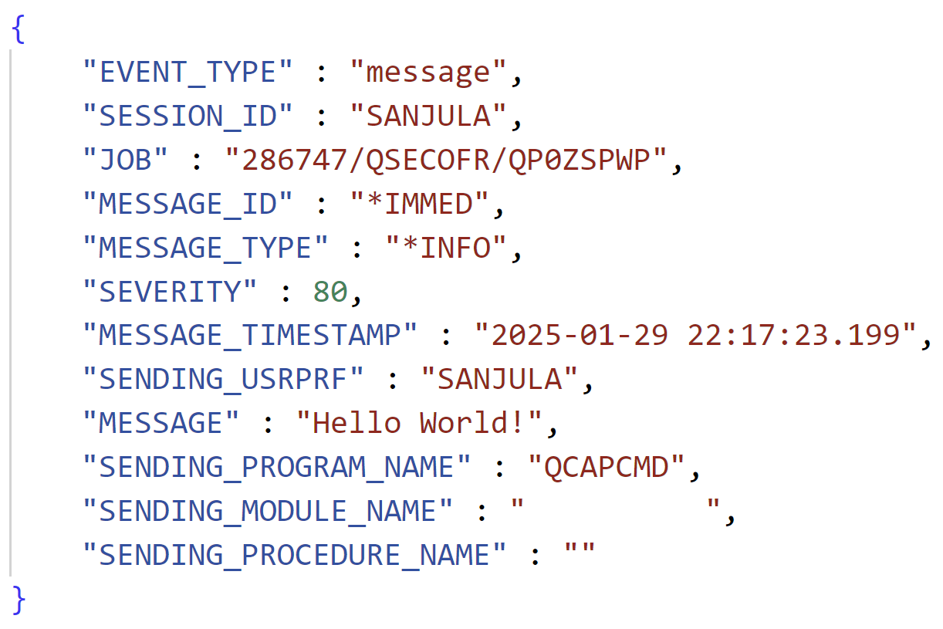
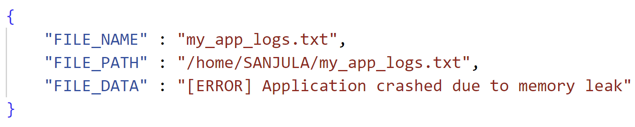
Understanding the Architecture: Handler and Distributor
Handler
Start system watches based on config files (data.ini)
Transform system event data into structured format
Add structured data to table or send over socket
Distributor
Fetch data off table or via socket
Send data to destinations using Apache Camel based on config files (dests.ini)
Data From Message Queue
Data From Stream File

Slide 35
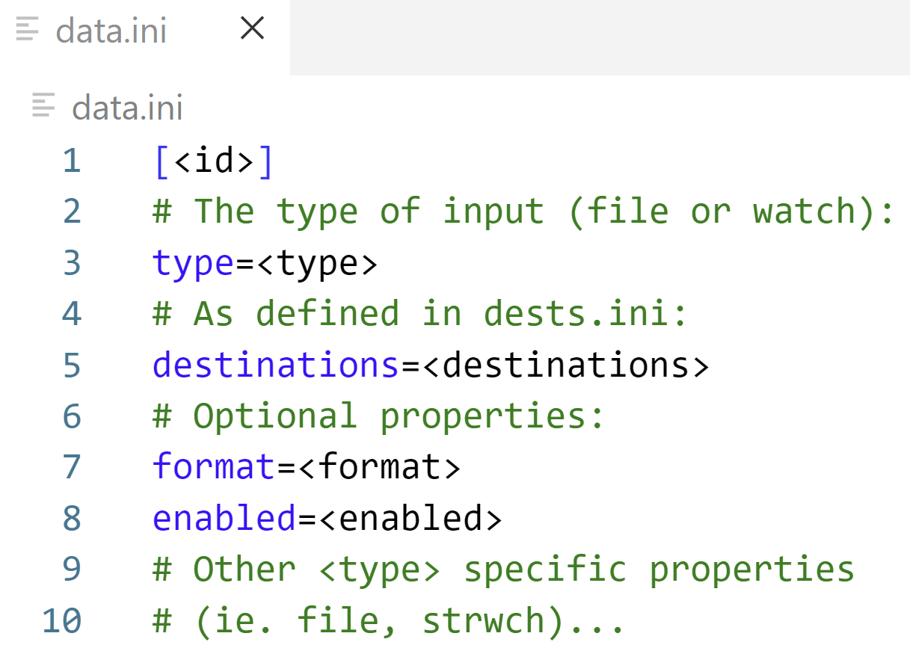
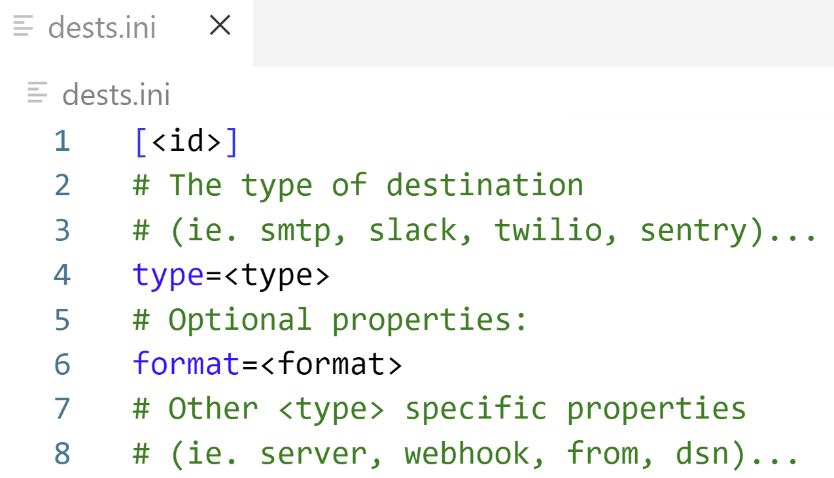
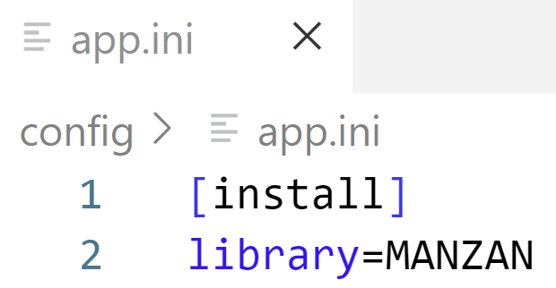
Configuring Inputs and Destinations
Configuration files are stored in /QOpenSys/etc/manzan
app.ini
data.ini
dests.ini
Used for general Manzan configuration (leave the default contents)
Used for configuring different inputs
Used for configuring different destinations

Slide 36
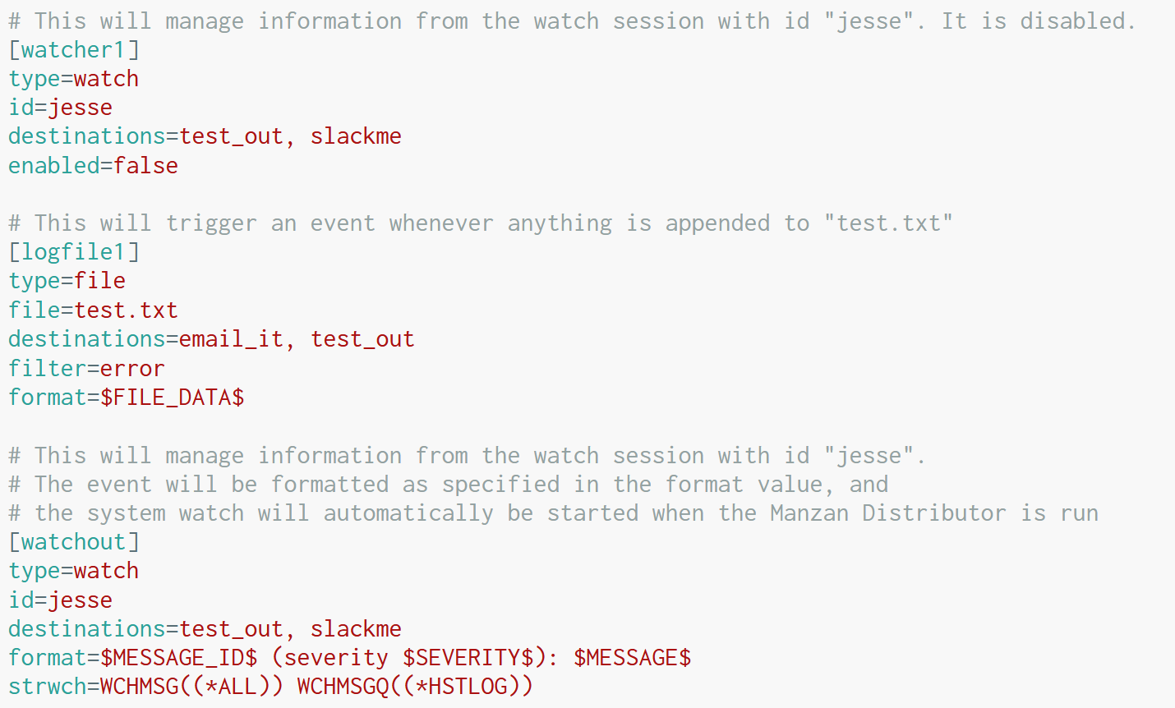
Simple data.ini configurations
Stream File
Watch application log file (test.txt) and only take action when a line written to the file contains the string “error”
System Watch
Manage information from watch session with id “jesse”

Slide 37
Advanced data.ini configuration
System Watch
Manage information from watch session with id “jesse” which watches all messages in the IBM i history log
Format the message into a human-sensible format

Slide 38
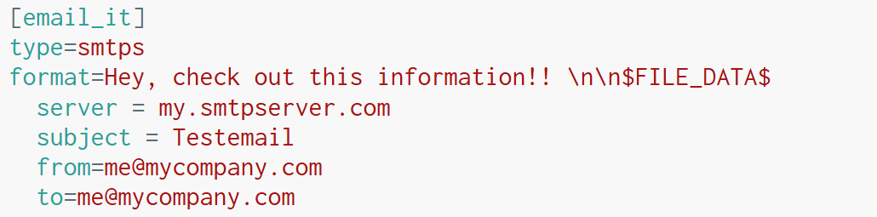
Example dests.ini configurations
Send to Manzan’s standard output
Send an email

Slide 39
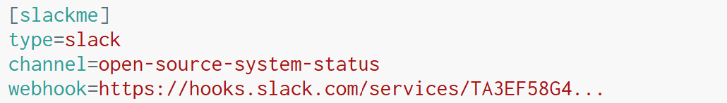
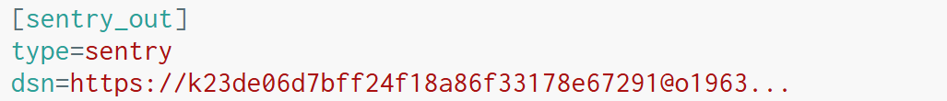
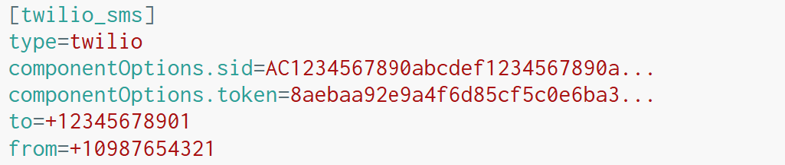
More example dests.ini configurations
Send message in Slack channel:
Send event to Sentry
Send SMS message with Twilio

Slide 40
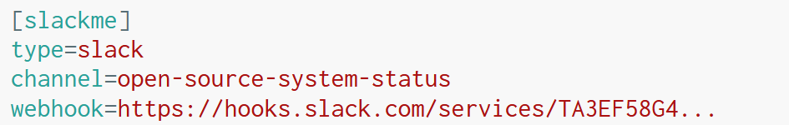
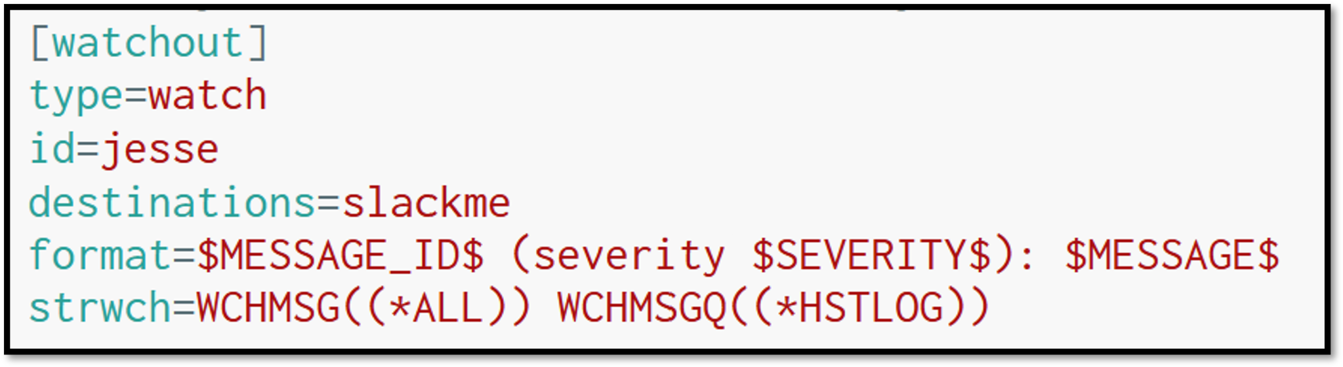
Let’s put it together…
dests.ini
data.ini

Slide 41
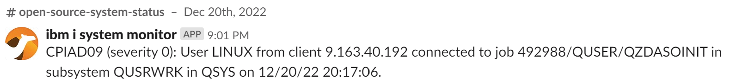
What does it look like in Slack?

Slide 42
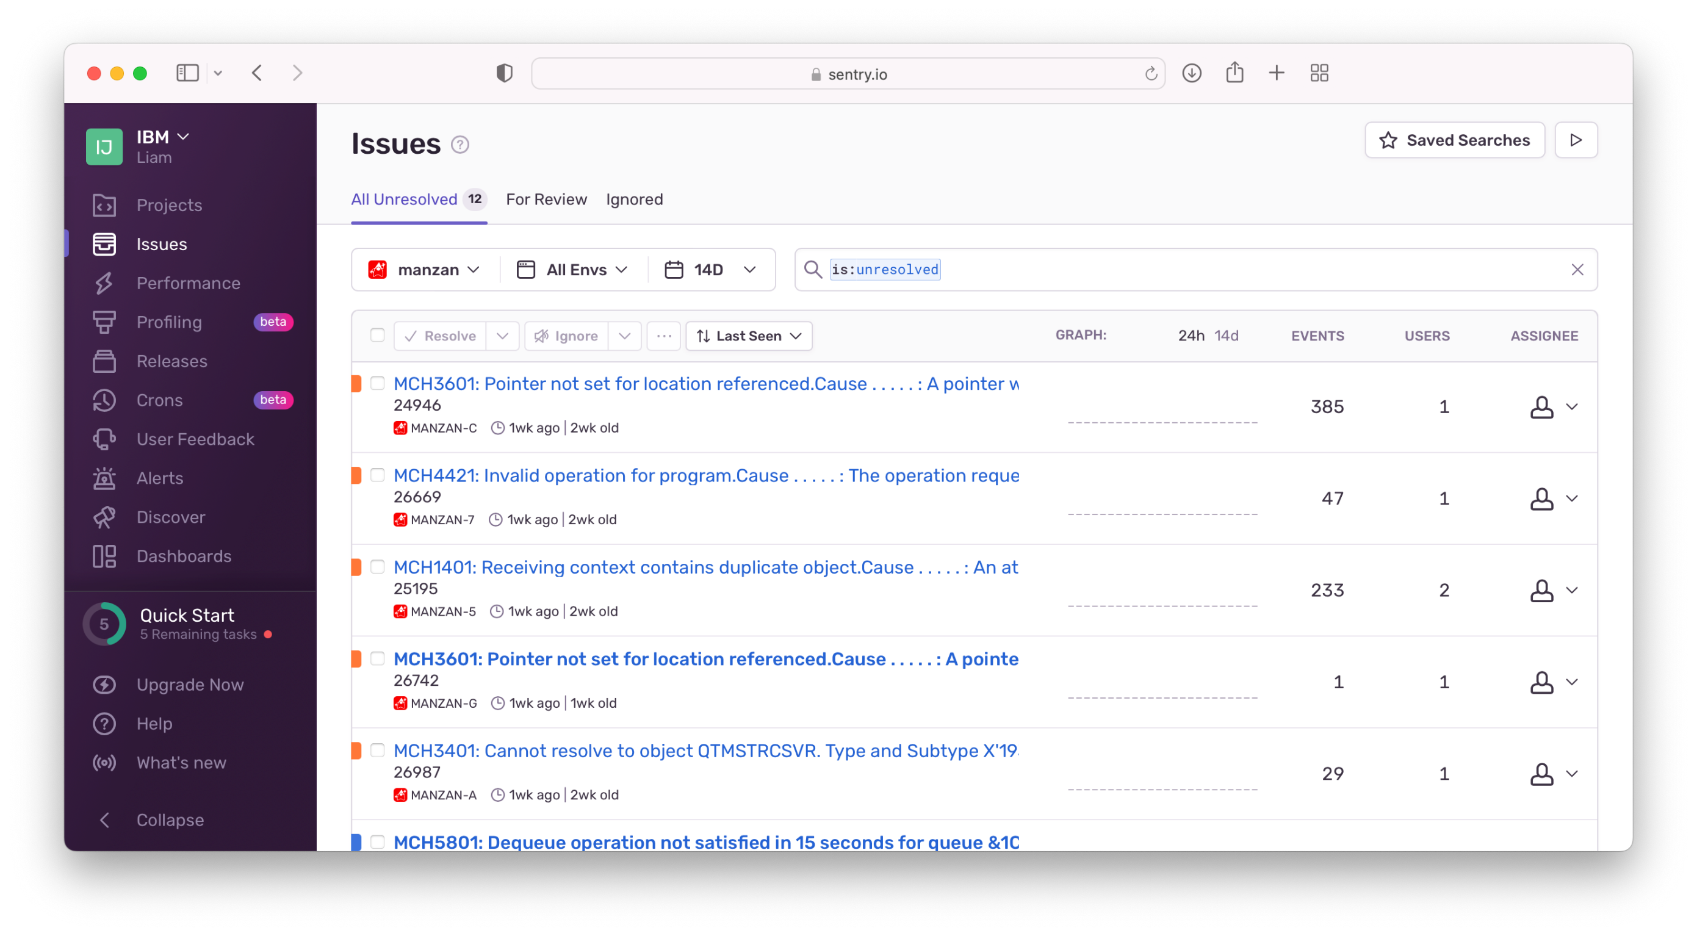
More examples…Sentry!

Slide 43
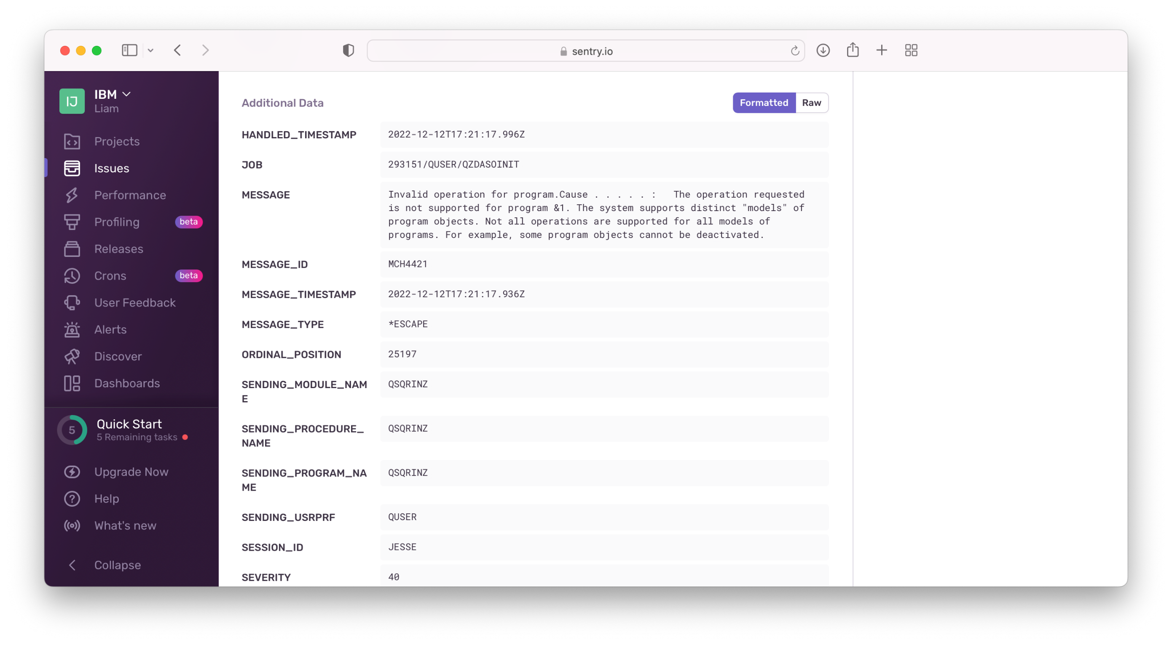
More examples…Sentry!

Slide 44
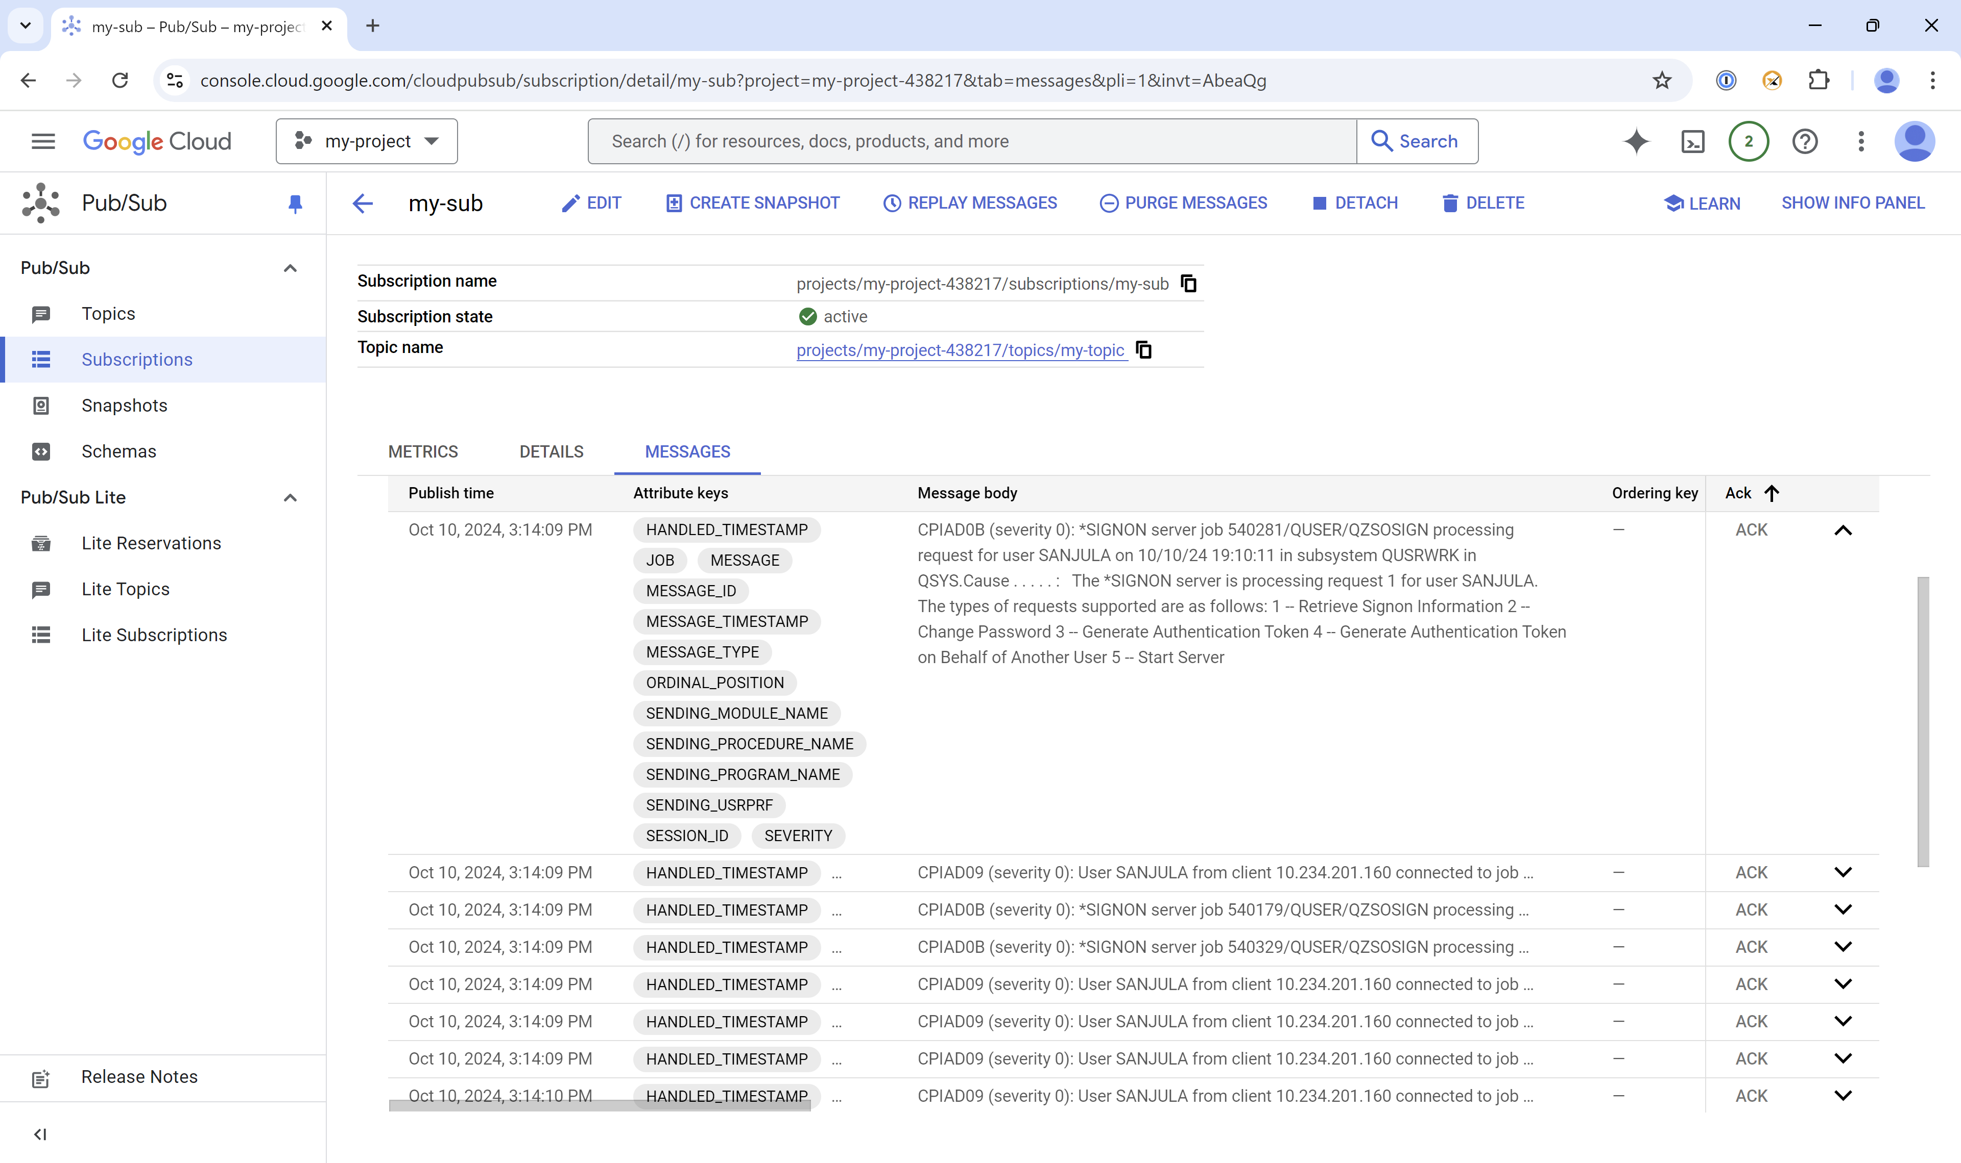
More examples…Google Pub/Sub!

Slide 45
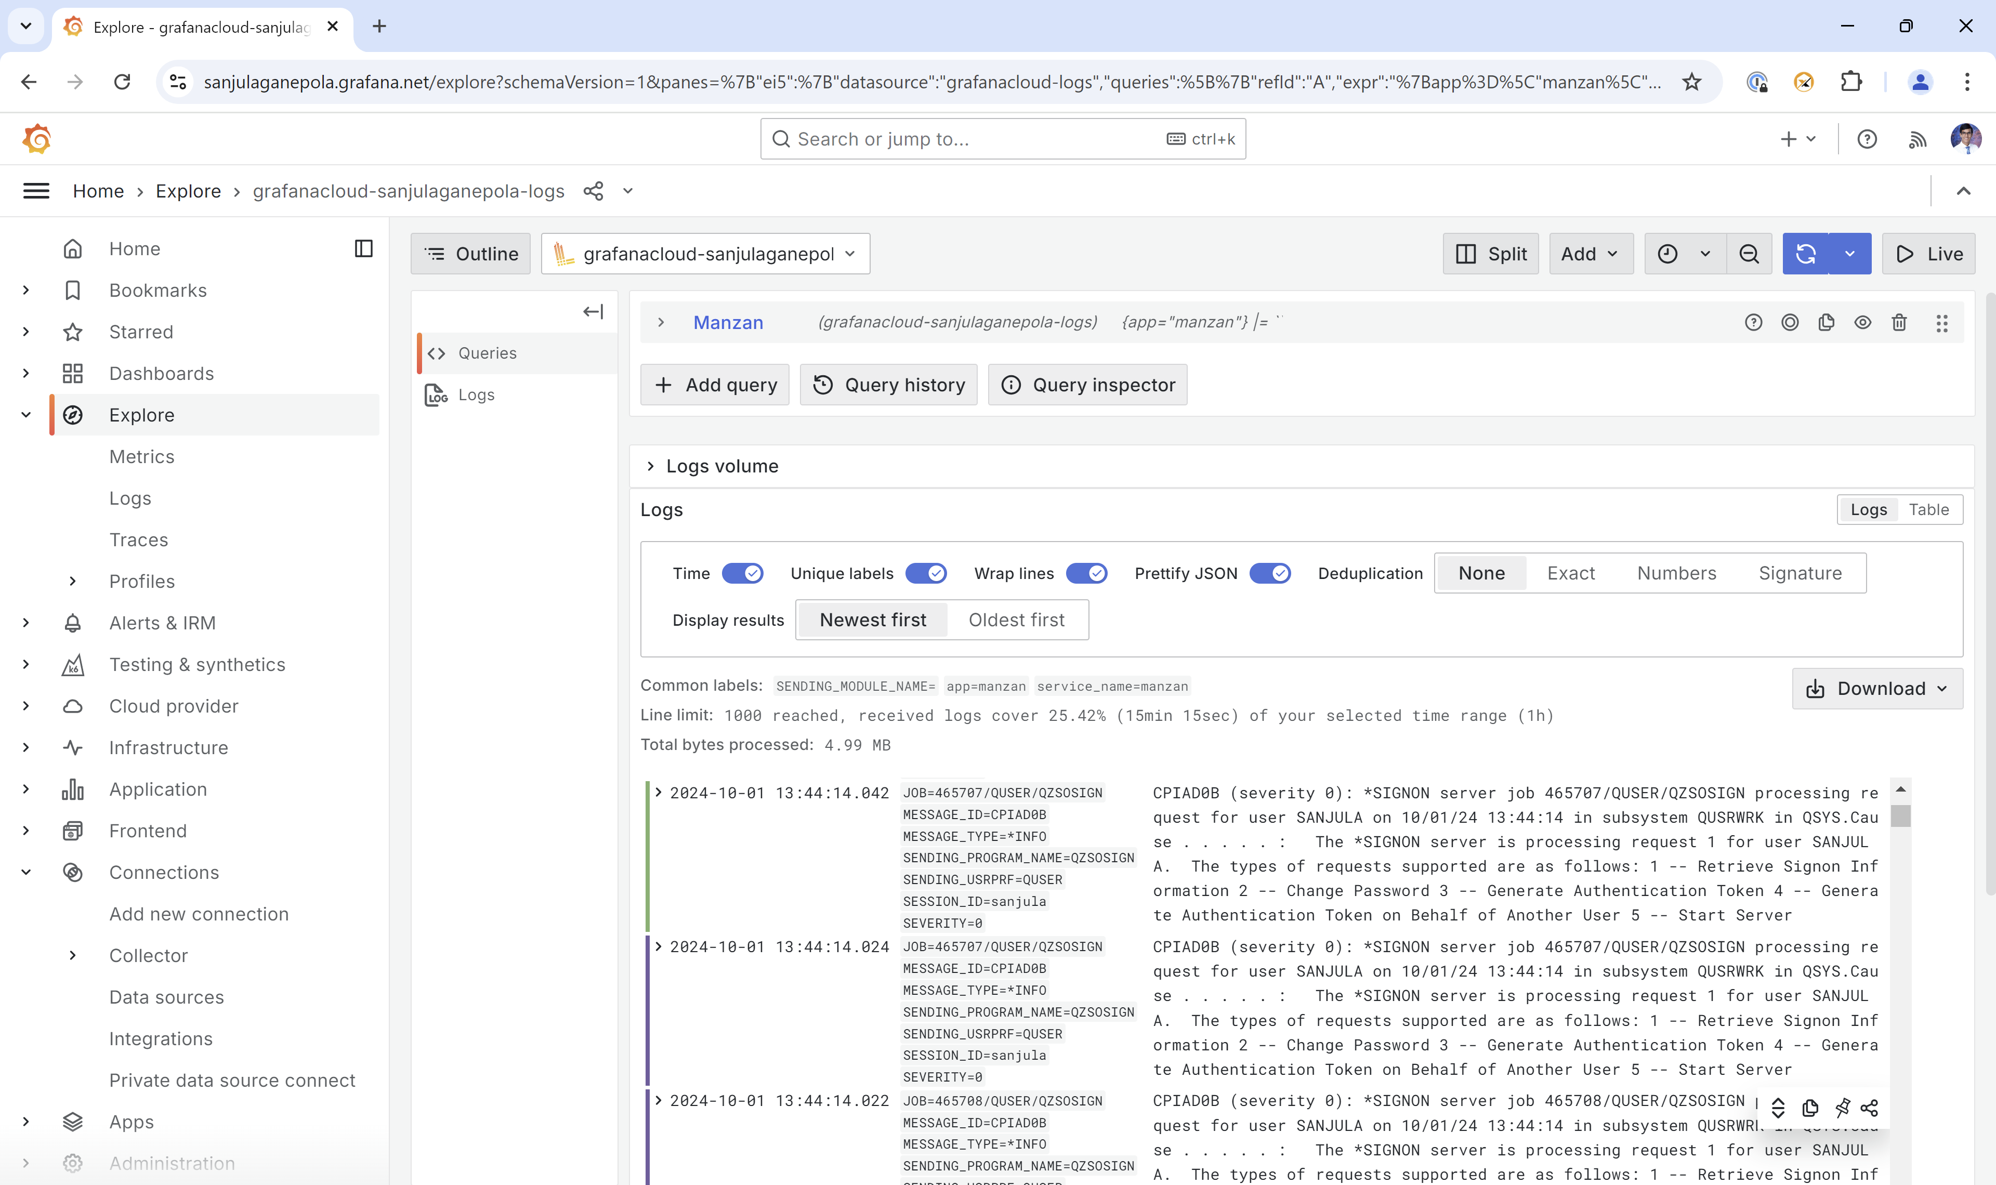
More examples…Grafana Loki!
Video Demo: https://www.youtube.com/watch?v=3XXjvkchCWc

Slide 46
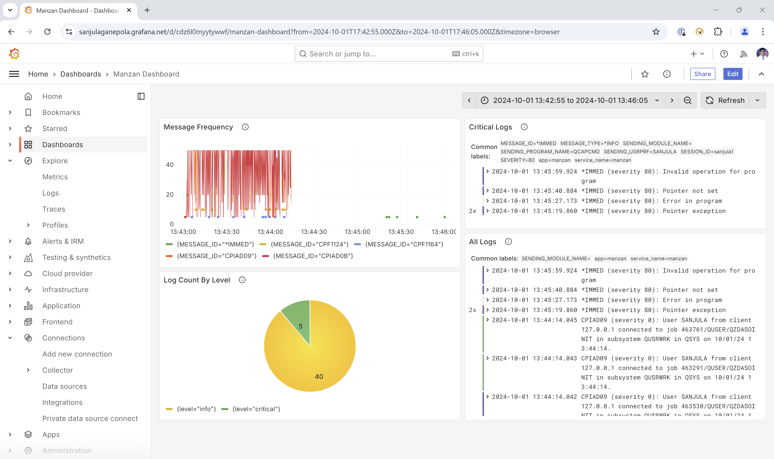
Visualize Logs in Grafana Dashboard

Slide 47
Future Enhancements to Manzan
Trigger events based on audit journals
System exit point processing
Metrics exported to Prometheus, for instance:
How many MCH exceptions have happened in production applications?
How many severity 40+ history log entries?
How many errors showing in web server logs?
How many PASE VLOGs have been created?
Ability to trigger events from Prometheus exporter, for instance:
Memory pool usage anomalies
Increased HTTP server traffic
Unexpected amount of remote connections
Operational data beyond thresholds

Slide 48
Manzan + AI

Slide 49
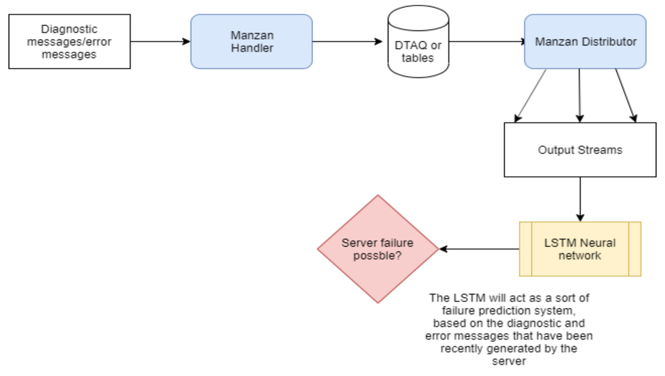
AI-Based System Monitoring: Failure Prediction System

Slide 50
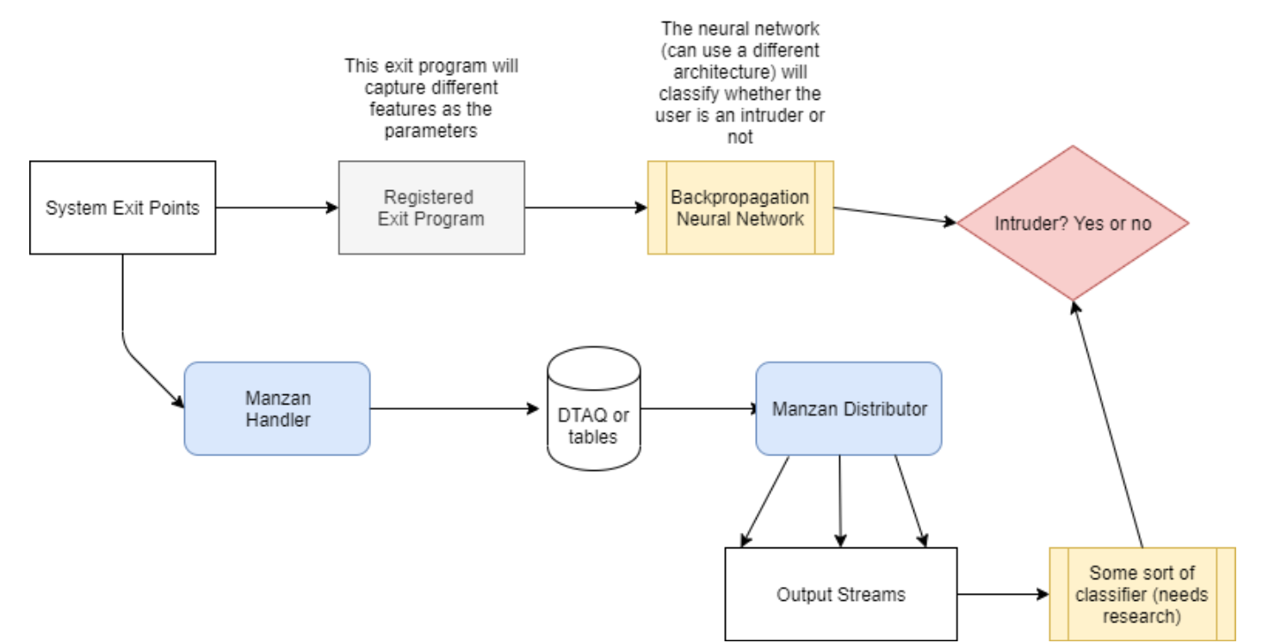
AI-Based System Monitoring: Intrusion Detection System

Slide 51
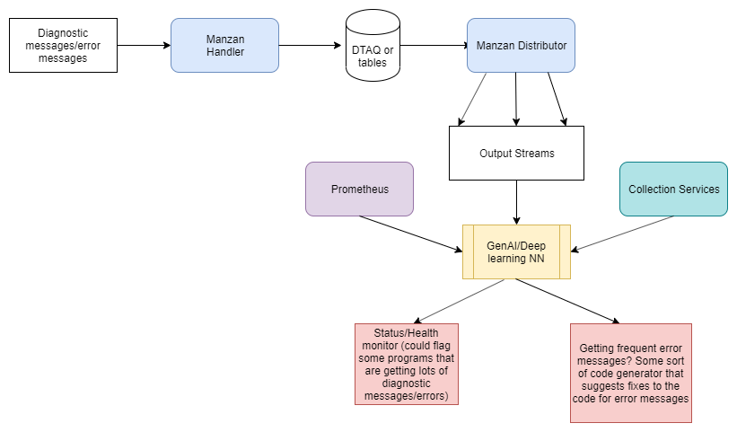
AI-Based System Monitoring: Health and Performance Assistant

Slide 52
Takeaways
Grafana is a must-have technology
01
Prometheus is a great way to enable ongoing monitoring
02
Manzan is a great way to handle various events and integrate with tons of solutions
03

Slide 53
Any Questions?

Slide 55
For more information IBM Sites:
IBM i Home Page | https://www.ibm.com/it-infrastructure/power/os/ibm-i
IBM Strategy Whitepaper | https://www.ibm.com/it-infrastructure/us-en/resources/power/i-strategy-roadmap/
IBM Client Success | https://www.ibm.com/it-infrastructure/us-en/resources/power/ibm-i-customer-stories/
Support Life Cycle | https://www.ibm.com/support/lifecycle/
License Topics | https://www-01.ibm.com/support/docview.wss?uid=nas8N1022087
IBM i Release Life Cycle | https://www.ibm.com/support/pages/release-life-cycle
IBM i TR Wikis | IBM i Technology Updates

Slide 56
For more information:
Blogs to follow
More to follow
Hashtags to Use
TechChannel You and i (Steve Will)
TechChanneli-Can (Dawn May)
TechChannel: iTalk with Tuohy
TechChannel: OpenYour i with Jesse Gorzinski
IBM Db2 for i (Kent Milligian)
IBM i Analyitics Blog (Jon Westcott Jr)
iSee with Scott and Tim
@IBMservers
@COMMONug
@IBMChampions
@IBMSystemsISVs
@LinuxIBMMag
@OpenPOWERorg
@ITJungleNews
@SAPonIBMi
@SiDforIBMi
@IBMAIXeSupp
@IBMAIXdoc
#IBMPower
#IBMi #IBMAIX
#Power10 #LinuxonPower #HANAonPower
#ITinfrastructure #OpenSource #HybridCloud

Slide 58
Special notices
This document was developed for IBM offerings in the United States as of the date of publication. IBM may not make these offerings available in other countries, and the information is subject to change without notice. Consult your local IBM business contact for information on the IBM offerings available in your area.
Information in this document concerning non-IBM products was obtained from the suppliers of these products or other public sources. Questions on the capabilities of non-IBM products should be addressed to the suppliers of those products.
IBM may have patents or pending patent applications covering subject matter in this document. The furnishing of this document does not give you any license to these patents. Send license inquires, in writing, to IBM Director of Licensing, IBM Corporation, New Castle Drive, Armonk, NY 10504-1785 USA.
All statements regarding IBM future direction and intent are subject to change or withdrawal without notice, and represent goals and objectives only.
The information contained in this document has not been submitted to any formal IBM test and is provided "AS IS" with no warranties or guarantees either expressed or implied.
All examples cited or described in this document are presented as illustrations of the manner in which some IBM products can be used and the results that may be achieved. Actual environmental costs and performance characteristics will vary depending on individual client configurations and conditions.
IBM Global Financing offerings are provided through IBM Credit Corporation in the United States and other IBM subsidiaries and divisions worldwide to qualified commercial and government clients. Rates are based on a client's credit rating, financing terms, offering type, equipment type and options, and may vary by country. Other restrictions may apply. Rates and offerings are subject to change, extension or withdrawal without notice.
IBM is not responsible for printing errors in this document that result in pricing or information inaccuracies.
All prices shown are IBM's United States suggested list prices and are subject to change without notice; reseller prices may vary.
IBM hardware products are manufactured from new parts, or new and serviceable used parts. Regardless, our warranty terms apply.
Any performance data contained in this document was determined in a controlled environment. Actual results may vary significantly and are dependent on many factors including system hardware configuration and software design and configuration. Some measurements quoted in this document may have been made on development-level systems. There is no guarantee these measurements will be the same on generally-available systems. Some measurements quoted in this document may have been estimated through extrapolation. Users of this document should verify the applicable data for their specific environment.
Revised September 26, 2006

Slide 59
Special notices (cont.)
IBM, the IBM logo, ibm.com AIX, AIX (logo), AIX 5L, AIX 6 (logo), AS/400, BladeCenter, Blue Gene, ClusterProven, Db2, ESCON, i5/OS, i5/OS (logo), IBM Business Partner (logo), IntelliStation, LoadLeveler, Lotus, Lotus Notes, Notes, Operating System/400, OS/400, PartnerLink, PartnerWorld, PowerPC, pSeries, Rational, RISC System/6000, RS/6000, THINK, Tivoli, Tivoli (logo), Tivoli Management Environment, WebSphere, xSeries, z/OS, zSeries, Active Memory, Balanced Warehouse, CacheFlow, Cool Blue, IBM Systems Director VMControl, pureScale, TurboCore, Chiphopper, Cloudscape, Db2 Universal Database, DS4000, DS6000, DS8000, EnergyScale, Enterprise Workload Manager, General Parallel File System, , GPFS, HACMP, HACMP/6000, HASM, IBM Systems Director Active Energy Manager, iSeries, Micro-Partitioning, POWER, PowerExecutive, PowerVM, PowerVM (logo), PowerHA, Power Architecture, Power Everywhere, Power Family, POWER Hypervisor, Power Systems, Power Systems (logo), Power Systems Software, Power Systems Software (logo), POWER2, POWER3, POWER4, POWER4+, POWER5, POWER5+, POWER6, POWER6+, POWER7, System i, System p, System p5, System Storage, System z, TME 10, Workload Partitions Manager and X-Architecture are trademarks or registered trademarks of International Business Machines Corporation in the United States, other countries, or both. If these and other IBM trademarked terms are marked on their first occurrence in this information with a trademark symbol (® or ™), these symbols indicate U.S. registered or common law trademarks owned by IBM at the time this information was published. Such trademarks may also be registered or common law trademarks in other countries.
A full list of U.S. trademarks owned by IBM may be found at: http://www.ibm.com/legal/copytrade.shtml.
Adobe, the Adobe logo, PostScript, and the PostScript logo are either registered trademarks or trademarks of Adobe Systems Incorporated in the United States, and/or other countries.
AltiVec is a trademark of Freescale Semiconductor, Inc.
AMD Opteron is a trademark of Advanced Micro Devices, Inc.
InfiniBand, InfiniBand Trade Association and the InfiniBand design marks are trademarks and/or service marks of the InfiniBand Trade Association.
Intel, Intel logo, Intel Inside, Intel Inside logo, Intel Centrino, Intel Centrino logo, Celeron, Intel Xeon, Intel SpeedStep, Itanium, and Pentium are trademarks or registered trademarks of Intel Corporation or its subsidiaries in the United States and other countries.
IT Infrastructure Library is a registered trademark of the Central Computer and Telecommunications Agency which is now part of the Office of Government Commerce.
Java and all Java-based trademarks and logos are trademarks or registered trademarks of Oracle and/or its affiliates.
Linear Tape-Open, LTO, the LTO Logo, Ultrium, and the Ultrium logo are trademarks of HP, IBM Corp. and Quantum in the U.S. and other countries.
Linux is a registered trademark of Linus Torvalds in the United States, other countries or both.
Microsoft, Windows and the Windows logo are registered trademarks of Microsoft Corporation in the United States, other countries or both.
NetBench is a registered trademark of Ziff Davis Media in the United States, other countries or both.
SPECint, SPECfp, SPECjbb, SPECweb, SPECjAppServer, SPEC OMP, SPECviewperf, SPECapc, SPEChpc, SPECjvm, SPECmail, SPECimap and SPECsfs are trademarks of the Standard Performance Evaluation Corp (SPEC).
The Power Architecture and Power.org wordmarks and the Power and Power.org logos and related marks are trademarks and service marks licensed by Power.org.
TPC-C and TPC-H are trademarks of the Transaction Performance Processing Council (TPPC).
UNIX is a registered trademark of The Open Group in the United States, other countries or both.
Other company, product and service names may be trademarks or service marks of others.
Revised December 2, 2010

